Slide 1
Psychology
3.3 Memory
Notes:
Pre-test – Ed Perfect

Slide 2
Recall, Recognition & Relearning

Slide 3
Learning Objectives
Contrast recall, recognition and relearning.
Describe problems with memory such as encoding failure, retrieval failure and interference effects.
Discuss strategies to improve memory, including spacing, interleaving, chunking, elaborative and maintenance rehearsal, and the method of loci.

Slide 4
Memory Retrieval
Research acknowledges the following four methods of memory retrieval (4 R’s)
Recall
Recognition
Relearning
Reconstruction
We will only focus on the first three

Slide 5
Recall
The retrieval of information using minimal cues.
There are three types of recall:
Free recall:
The recollection of as much information as possible without any cues
Serial recall:
Recalling information in the order it was presented
Cued recall:
Recall assisted by prompts/hints (cues) to aid retrieval without using the original terms
Least sensitive form of retrieval
Notes:
Use the alphabet as an example
Free Recall – give letters of the alphabet in any order
Serial Recall – ABCDEFG
Cued recall – Second letter of the alphabet
Sensitivity refers to how well information will be retrieved. The higher the sensitivity the better the recall
A highly sensitive measure can retrieve information even if only a portion of the original information is in tact
A less sensitive measure will only retrieve the information if the memory is largely in tact

Slide 6
Recognition
A form of retrieval where the correct information needs to be identified amongst a set of alternatives
This differs to cued recall as the original information is presented
E.g. multiple choice test
Considered to be more accurate than recall
More cues to assist with recall

Slide 7
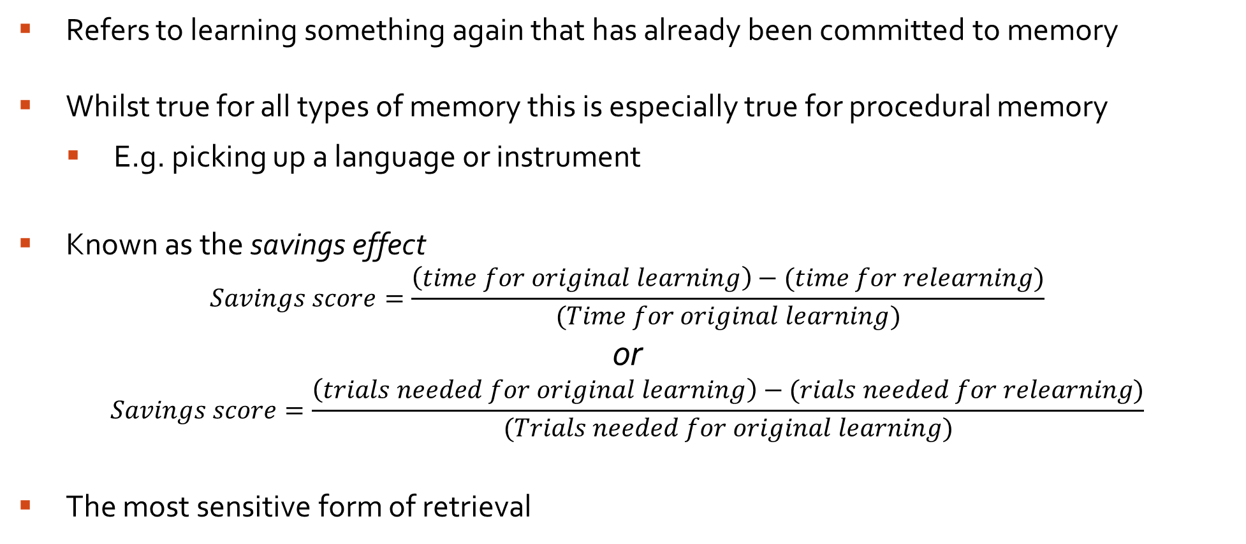
Relearning
Refers to learning something again that has already been committed to memory
Whilst true for all types of memory this is especially true for procedural memory
E.g. picking up a language or instrument
Known as the savings effect
$$Savings score=\frac{\left(time for original learning\right)−(time for relearning)}{(Time for original learning)}$$
or
$$Savings score=\frac{\left(trials needed for original learning\right)−(rials needed for relearning)}{(Trials needed for original learning)}$$
The most sensitive form of retrieval
Notes:
POP QUIZ:
Get students to identify the difference between declarative and procedural memory
Declarative: Personal experiences , events (Episodic), facts (Semantic) - Explicit
Procedural: Learning, actions, skills, do not necessarily require conscious thought – Implicit
Trials same as number of attempts

Slide 8
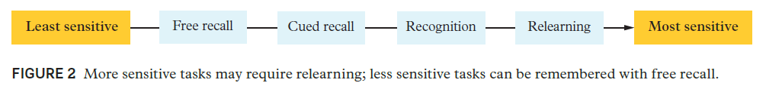

Slide 9
Complete the table to contrast:
 | Similarity | Difference
Recall
Recognition
Relearning

Slide 10
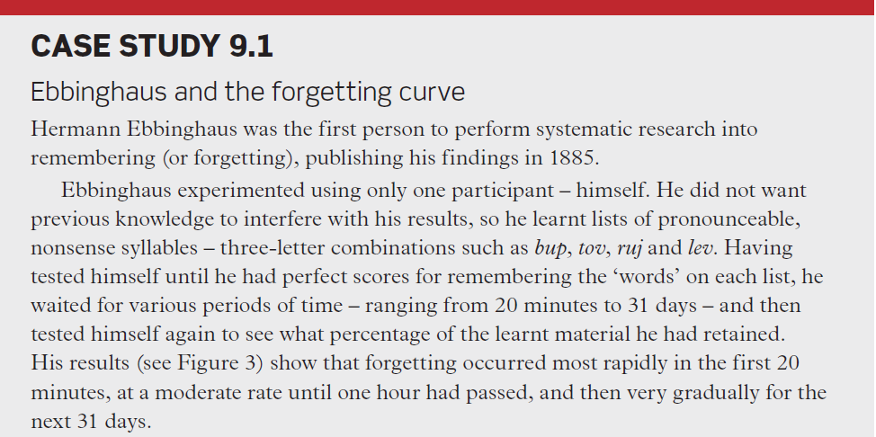

Slide 11
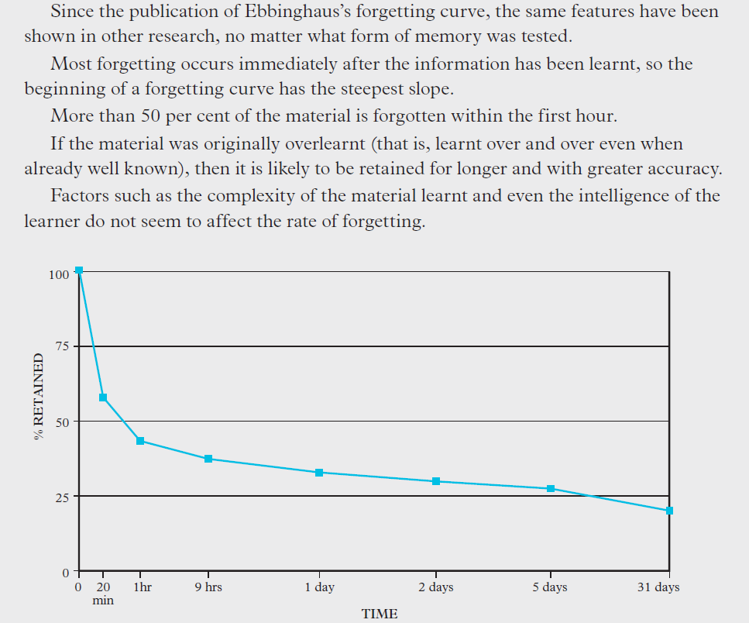

Slide 12
Why we Forget

Slide 13
Learning Objectives
Contrast recall, recognition and relearning.
Describe problems with memory such as encoding failure, retrieval failure and interference effects.
Discuss strategies to improve memory, including spacing, interleaving, chunking, elaborative and maintenance rehearsal, and the method of loci.

Slide 14
1 - Encoding Failure
Relates to the encoding specificity principle (Tulving & Thomson, 1973)
Provides a general theoretical framework for understanding how contextual information affects memory.
Specifically, the principle states that memory is improved when information (associations/context) available at encoding is also available at retrieval.
For example, the encoding specificity principle would predict that recall for information would be better if subjects were tested in the same room they had studied in versus having studied in one room and tested in a different room
Two main conditions that assist with retrieval – External environment and internal environment
Notes:
States that the associations formed at the time of encoding new memories are the most effective retrieval cues and that without those cues it may be difficult to retrieve this information
e.g. Spectacles, monocle, vision, glasses, contact lesson
Mugs, goblets, glasses, tumblers, beakers
Think of the context of the word glasses due to the associations with the other information available

Slide 15
External Environment
Refers to the context in which the memory was formed
Referred to as context dependent cues
Environmental cues include:
Smells, sounds, temperature, the physical environment etc.
If these same cues are present at the time of retrieval, then it will be easier to remember
Notes:
Use these daily
e.g. can’t remember where your keys are so you ‘retrace your steps’. You go to the laundry (where you put your dirty gym gear) suddenly remember you went to the gym, check your gym bag and there are your keys
e.g. Taking witnesses back to the scene of the crime

Slide 16
Internal Environment
Refers to the internal context (Physiological/psychological state) in which the memory was formed
Referred to as state dependent cues
Internal cues include:
Mood, level of anxiety, medication, intoxication etc.
If these same cues are present at the time of retrieval, then it will be easier to remember
E.g. learning in a calm classroom vs highly aroused anxious state when sitting an exam

Slide 17
Ineffective encoding
Helps to explain occasions where we think we have forgotten something, but in reality it was never properly encoded
Example are:
Pseudo forgetting: when you think there is a memory you have forgotten but the memory was never stored – generally caused by lack of attention
Disruption to consolidation: consolidation is where the brain creates a permanent record of a memory, if this process is disrupted then the information will not be readily remembered

Slide 18
2 - Retrieval Failure theory
Proposed by Tulving and Thomson (1973) –
Suggests the inability to retrieve material is due to an absence of the right cues or failure to use the correct cues
In other words the memory is there but not accessible
Sometimes called cue – dependent forgetting
Retrieval cues can be anything associated with encoding the memory
Environmental, internal, verbal, physical etc
A good retrieval cue is as similar as possible to the original encoding of the information - i.e. If emphasis was placed on a particular sound that same emphasis should be present at retrieval

Slide 19
Tip of the Tongue (TOT) phenomenon
Refers to feeling like we know something and even being able to frame or shape the memory in our minds but being unable to retrieve the memory indicating some retrieval failure but also possibly interference
E.g. trying to remember someones name
being able to remember their face, what they may have been wearing, maybe similar sounding names or ones that begin with the same letter, even the length of the name
An indication that memories are stored in different areas of the brain

Slide 20
3 - Interference effects
Becoming confused, or mixing up information could be the result of interference effects
The interference theory suggests that difficulty retrieving could be due to:
Proactive interference: When previously learned material inhibits our ability to encode and store new information
Retroactive interference: When newly learned material inhibits our ability to retrieve previously learnt material

Slide 21
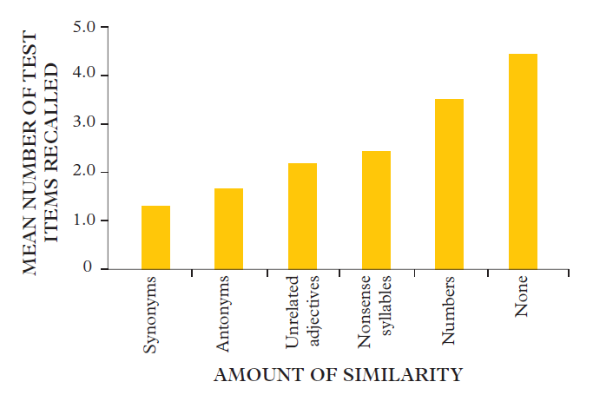
Effect of Similarity on Retrieval
Interference is generally stronger when two sets of material are very similar.
This idea has been supported by evidence as can be seen in the study by McGeoch and McDonald (1931).
Notes:
e.g. Spanish and Italian vs Spanish and Japanese
McGeoch & McDonald 1931
In their study they got participants to memorise a list of words
After a short break participants then were asked to remember an additional list of words
The list of words provided varied in similarity to the original list
They found that words with higher similarity

Slide 22
Strengths and Limitations of Interference Theory
Strengths:
Plausible
Research has been replicated
People do experience this phenomenon
Weaknesses:
Relies on recall tests which are prone to ‘interference’
May not be occur as readily in every day life (i.e. semantic memory is used often and less likely to suffer from interference)

Slide 23
Improving Memory

Slide 24
Learning Objectives
Contrast recall, recognition and relearning.
Describe problems with memory such as encoding failure, retrieval failure and interference effects.
Discuss strategies to improve memory, including spacing, interleaving, chunking, elaborative and maintenance rehearsal, and the method of loci.

Slide 25
1 - Spacing
A study technique where material is reviewed over a long period of time
Mind forms connections between the ideas and concepts over time
Information makes its way to long-term memory
Allows for knowledge to be built upon and faster recall later
The purpose is to provide a chance to (almost) forget before the material is revisited
When the brain has almost forgotten something, it works harder to recall that information
Gives the brain a workout each time the material is revisited!
Better than cramming - information is stored in short-term memory and quickly forgotten
How to:
Day 1: Initial study session Next day: Revisit & Review After 3 days: Revisit & Review After 1 week: Revisit & Review After 2 weeks: Revisit & Review

Slide 26
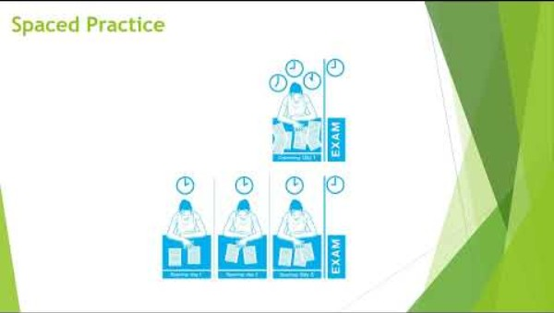

Slide 27
2 - Interleaving
To arrange something in alternate layers
As a study method means learning more than one subject or skill and switching between them
Mixing different topics or subjects while studying, rather than focusing on one area at a time
Shown to help enhance long-term retention and improves problem-solving skills by encouraging the brain to make connections between varied information
It contrasts with blocked practice, where similar topics are grouped together in study sessions, which can lead to superficial understanding and lower retention over time

Slide 28
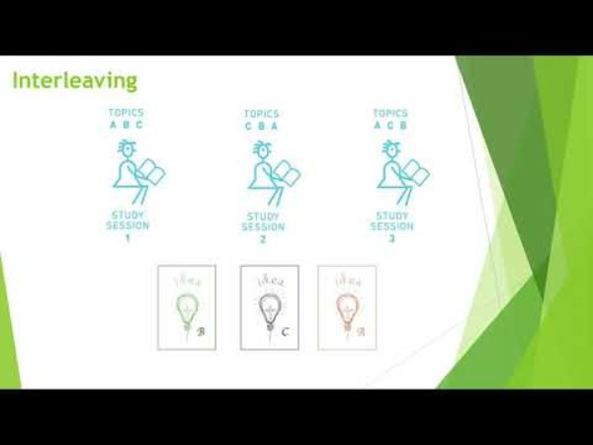

Slide 29
3 - Chunking
Grouping of things together to improve memory capacity
Especially good for STM which improves encoding to LTM
Can help to overcome the limited capacity of STM
Even more successful when meaning is applied to the chunks to aid with deep level processing into LTM
e.g. remembering a phone number
It is easier to remember a number if you group the digits into 2, 3 or 4 or to remember a specific date if meaning is applied to it (birthday, event etc.)

Slide 30
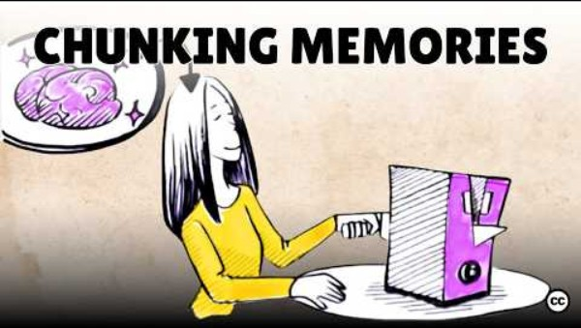

Slide 31
4 - Rehearsal
Maintenance Rehearsal:
Strategy to move information from STM to LTM by repeating it over and over
Keeps information in STM for longer (if no interruptions)
No meaning added to information
Elaborative Rehearsal:
Process of giving meaning to information or linking it to pre-existing information to increase encoding
‘like a brick in a wall’

Slide 32
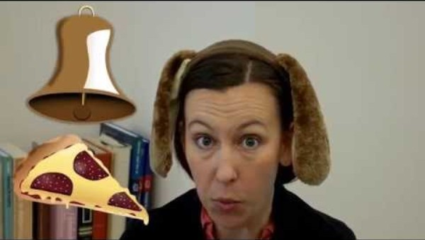

Slide 33
5 – Method of loci
Helps improve both encoding and retrieval
A mnemonic that focuses on visualisation to strengthen memory (memory palace)
It involves visualising a well-known location in your mind
It should be well known enough that you can very easily visualise it and walk through the location in your mind – a mental map (e.g. your house)
This method involves placing items of information in unique places in the mental map making them easier to encode and retrieve

Slide 34

https://www.youtube.com/watch?v=mh9B5UJbbRg
Notes:
https://www.youtube.com/watch?v=p9IOqd1LpkA
3, 14, 1, 5, 9, 2, 6

